Slide 1
VR Zombie Game
1155110979 Kwan Ting Fung

Slide 2
Introduction
Virtual Reality enables us to experience some amazing fiction.
One of the popular and amazing genre is Zombie Apocalypse.
My project is to implement a zombie VR game.

Slide 3
Original Implementation Goal
To be immersive in a zombie world:
Teleport locomotion
Spatial Sound Effect
Interactive level design

Slide 4

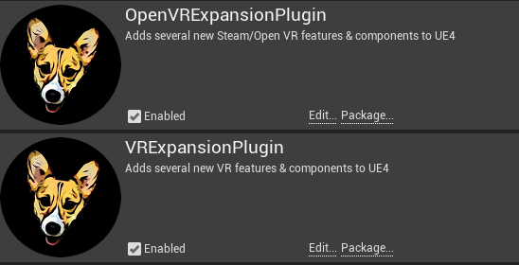
Method
Plugins:

Slide 5


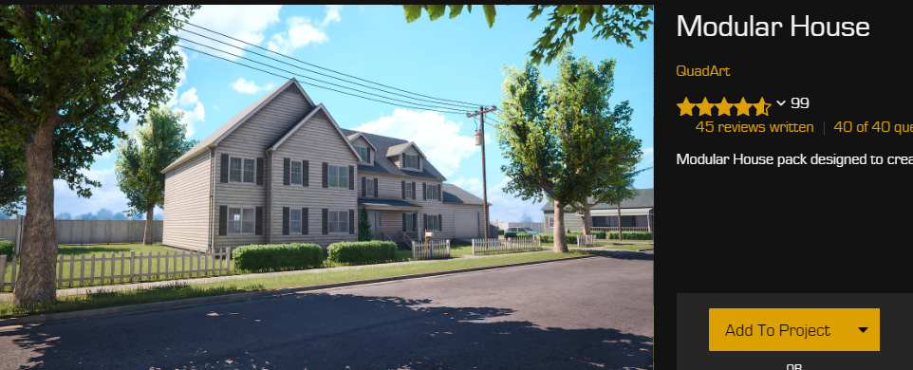
Assets in Game

Slide 6

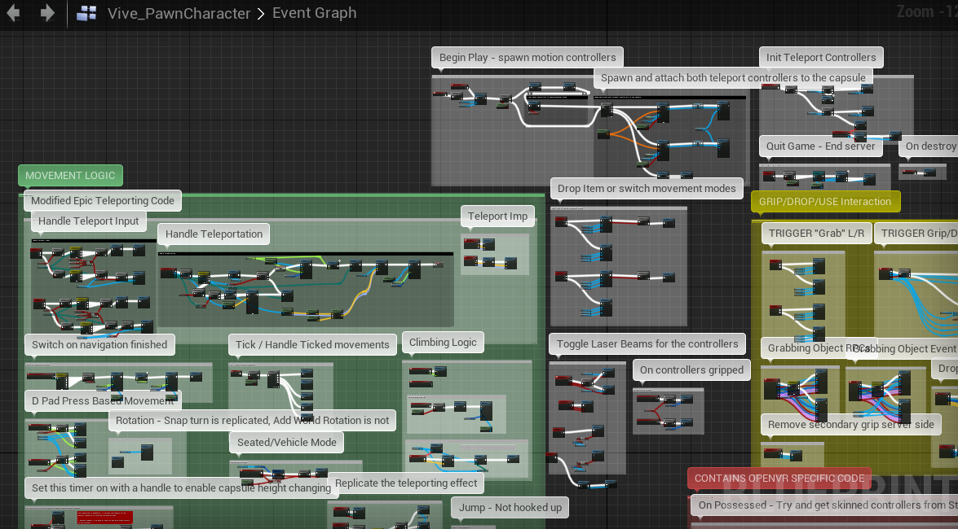
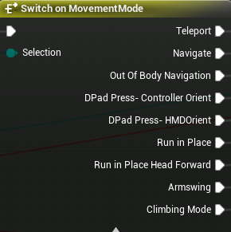
Locomotion
It already contains
7 methods of locomotion:

Slide 7

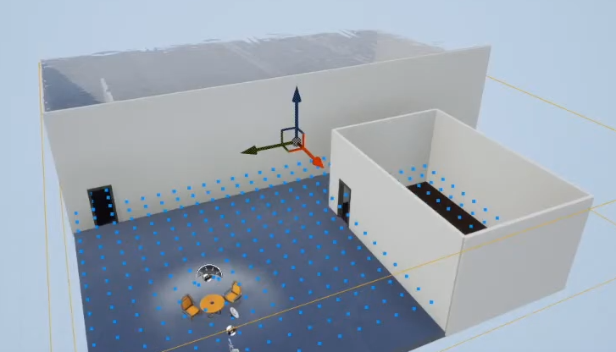
Spatial Sound Effect
Enable occlusion
Set up attenuation for each sound source
Add material type of other game object
(i.e. Wall: Concrete)
Bake / Realtime
Bake: Add probe volume
=> cover all traversable area

Slide 8
Interactive Level Design
The plugins provide functions for gripping and some assets as example.
Interactive stuff I created with the help of plugins:
Climbing system
Drawers
Gun system with mag reloading
Flashlight
Grippable zombie deadbodies

Slide 9
DEMO

Slide 10
Discussion
Compare to Half-Life alyx, , the plugin controller design and locomotion is trash.
The camera of continuous mode is moving linearly => motion sickness.
Flaw:
My game doesn’t have inventory system, menu, and sufficient guidence.
The light baking is always crashed with unknown reason.

Slide 11
Conclusion
Comparing the best VR game: Half-Life Alyx,
there is so much to learn how to make a great VR game,
and it is way more time-consuming than making usual PC game.
i.e. - good locomotion for lesser motion sickness
HUD design
Better physics are essential for polishing.
Goal attained: locomotion | sickness for me
spatial sound effect | OK
interactive level | Done

Slide 12
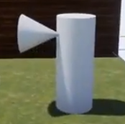
Spatial Sound Effect
Flaw:
All sound source is taken as point source.
In real life: there are sources like spot light.
Baking methods require a really reallt good hardware,
which I found out that even a simple level, it takes you two days literally.

Slide 13
Thank you

Slide 14
Q & A

